Slide 1
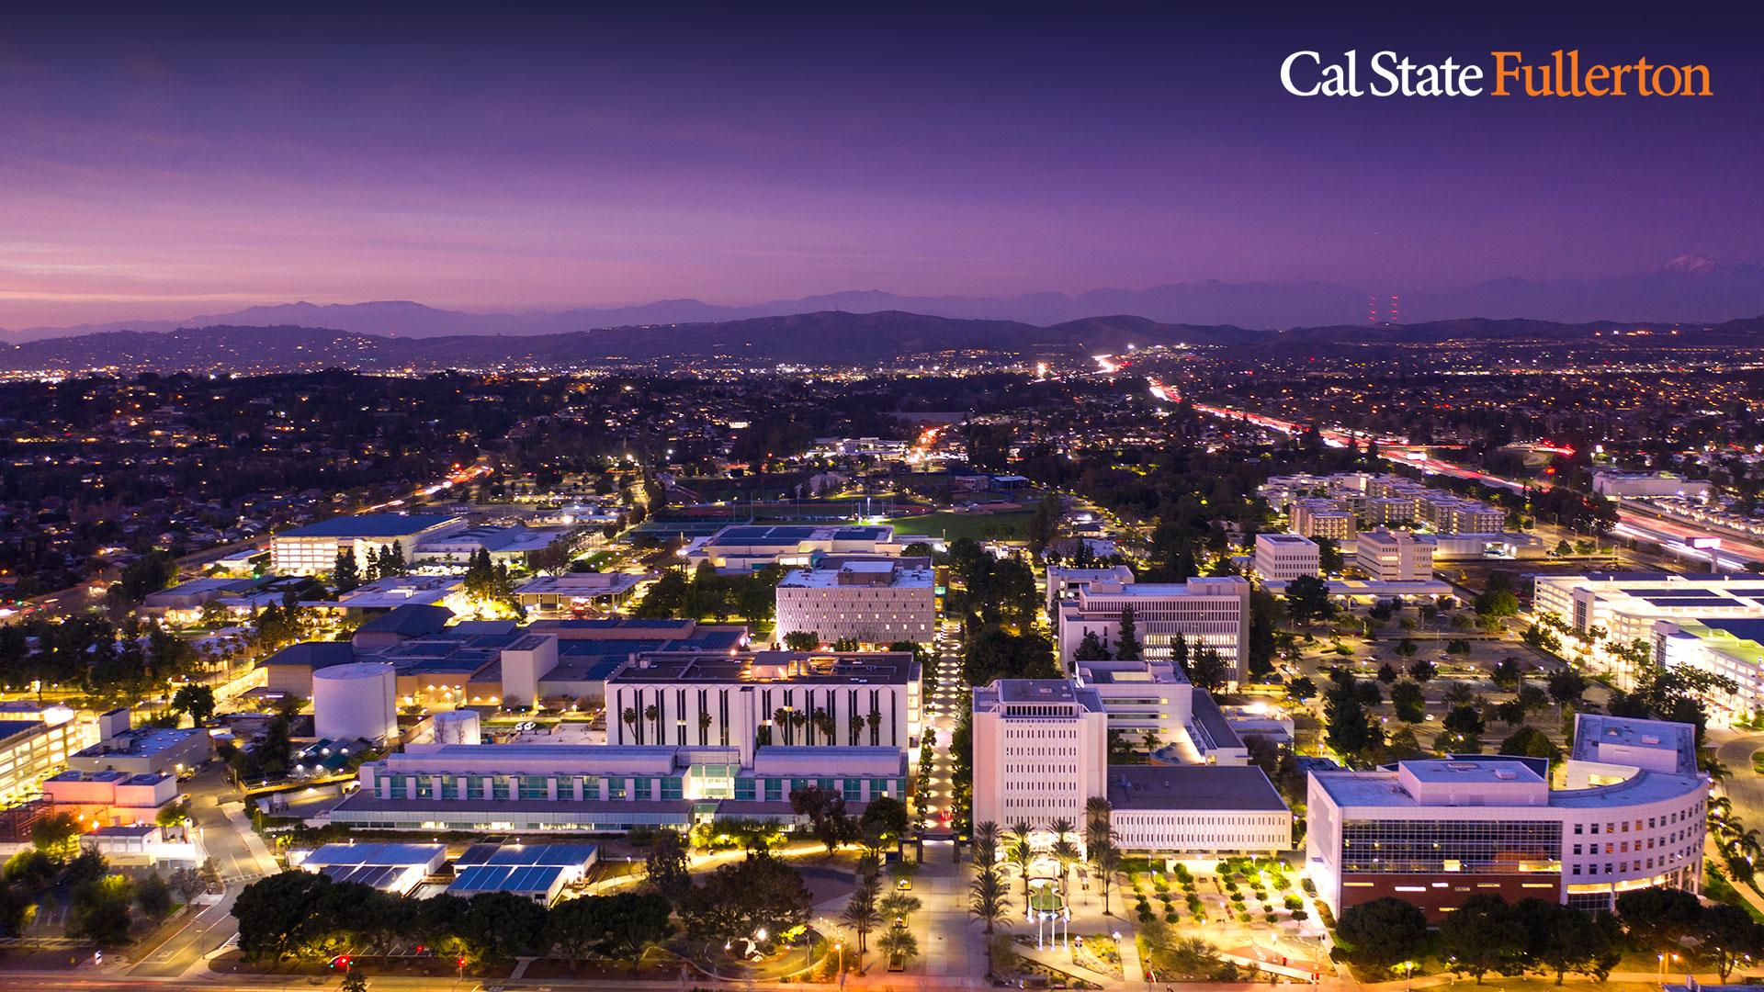
Referee Bias and Racial Discrimination
in the English Premier League:
A Machine Learning Analysis
CPSC 597 - Final Project
Professor Rong Jin
December 9th, 2025
Presented by Erwin Medina

Slide 2
Objective, Hypotheses, and Significance
Objective | To create a machine learning model that can analyze data and identify statistically significant patterns in referee decision-making.
Hypothesis [1] | Can the model determine who the referee is based on game statistics, and stadium information? [Referee Predictor]
Hypothesis [2] | Using the same information, does the model lean on the foreigners being carded as an important feature? [Racial Bias / Discrimination]
Hypothesis [3] | Can the model determine if a game was a win/loss/draw with game statistics, referee info, stadium information? [Match Outcome Predictor]
Significance | Identifying and evaluating referee biases to ensure fairness and transparency in the sport of football.

Slide 3
Data Collection
Dataset | Description/Summary | Sources
[1] Incident Reports Per Match + Statistics | Found existing csv dataset that had information on players who received yellow/red cards, goals scored, penalties scored/missed, along with their timestamps. Dataset contained statistical data: final score, possession %, shots, free kicks, fouls, and much more. Date Range: [2002-2022] | Link to Kaggle Dataset Match Report Example
[2] Foreign Player Names + Nationalities | Collected foreign players only, along with nationalities. All referees were English, so I only needed non-English players for racial discrimination analysis. | Wikipedia Link to Foreign Players Dataset
[3] Referee Names + Birth Cities | Collected referee names, nationality, and city of birth. | TransferMarkt.us Google

Slide 4
Data Cleaning/Normalization
Dataset | Summary
[1] Incident Reports | Recollected all of the incident reports due to language issues. Recollected all game statistics due to inconsistencies. Dropped 2002-2008 years due to missing referee info. Collected missing years [2023-2025] to make dataset more complete Used this as the ‘master’ dataset [“source of truth”]
[2] Player Info | Incident report = “LastName FirstInitial” [Ex: Calafiori R.] Player Info Dataset has full player name. Nicknames, singular names, or multiple names made normalization difficult. Fuzzy match not helpful [Martinez A. vs Martinez L.] Non-English Alphabet [Luděk Mikloško (Player Dataset) → Miklosko L. (Incident Report)] More than 2 names [Sepp van den Berg (Player Dataset) → Berg van den S. (Incident Report)]
[3] Referee Info | Straightforward; none needed.
Incident Report:
Hulk
Messi
Player Name Dataset:
Givanildo Vieira de Sousa
Lionel Messi

Slide 5
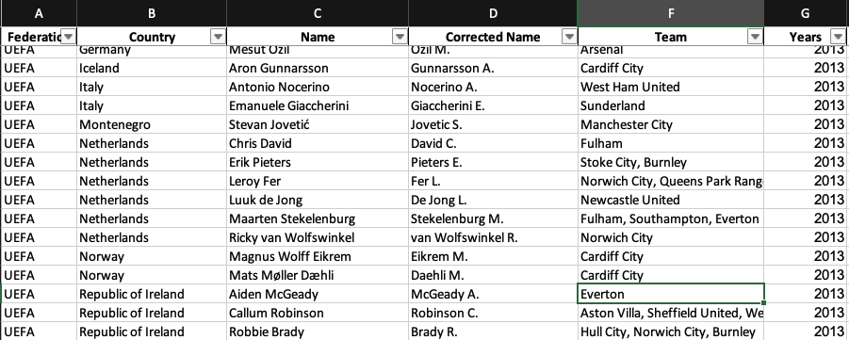
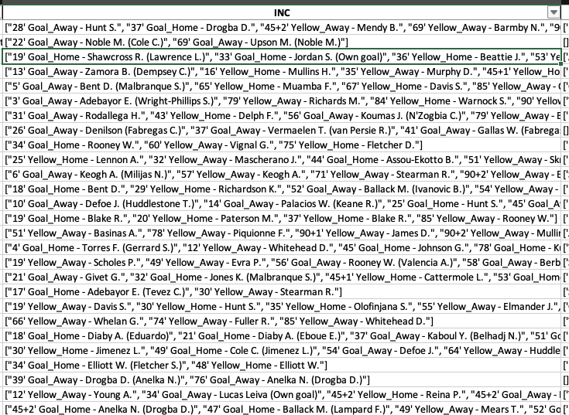
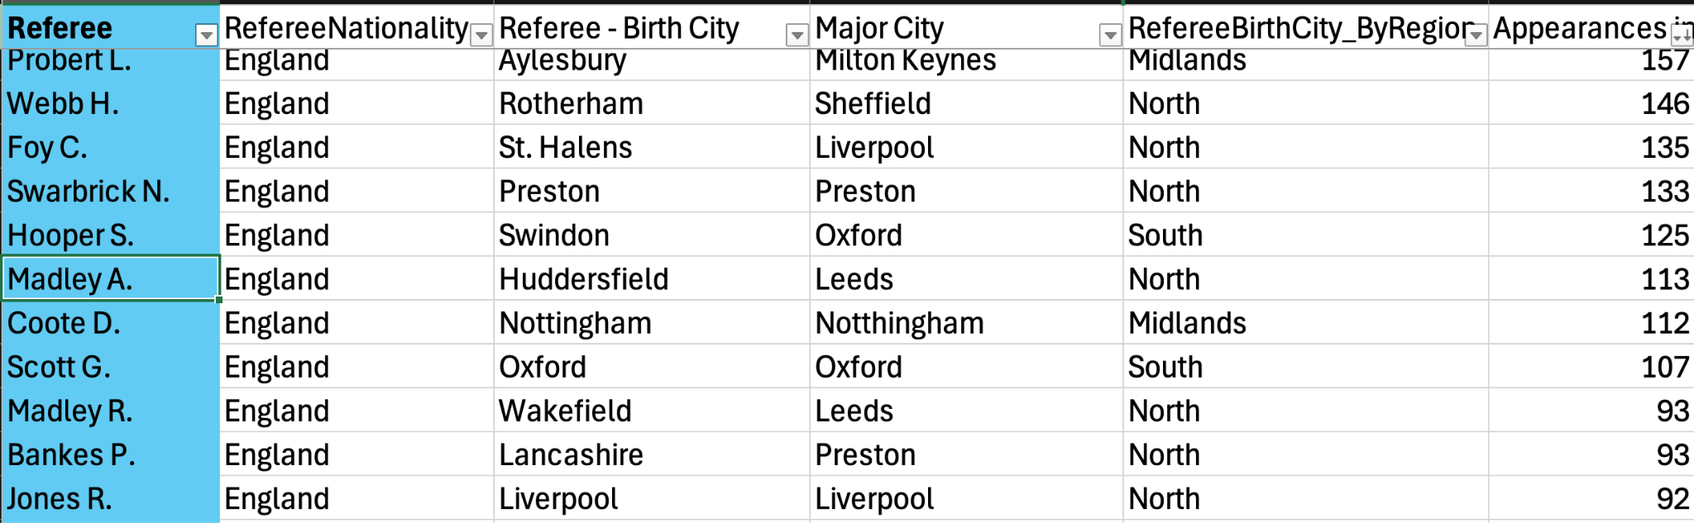
Examples of Datasets
Player Info
Incident Report
Referee Info

Slide 6
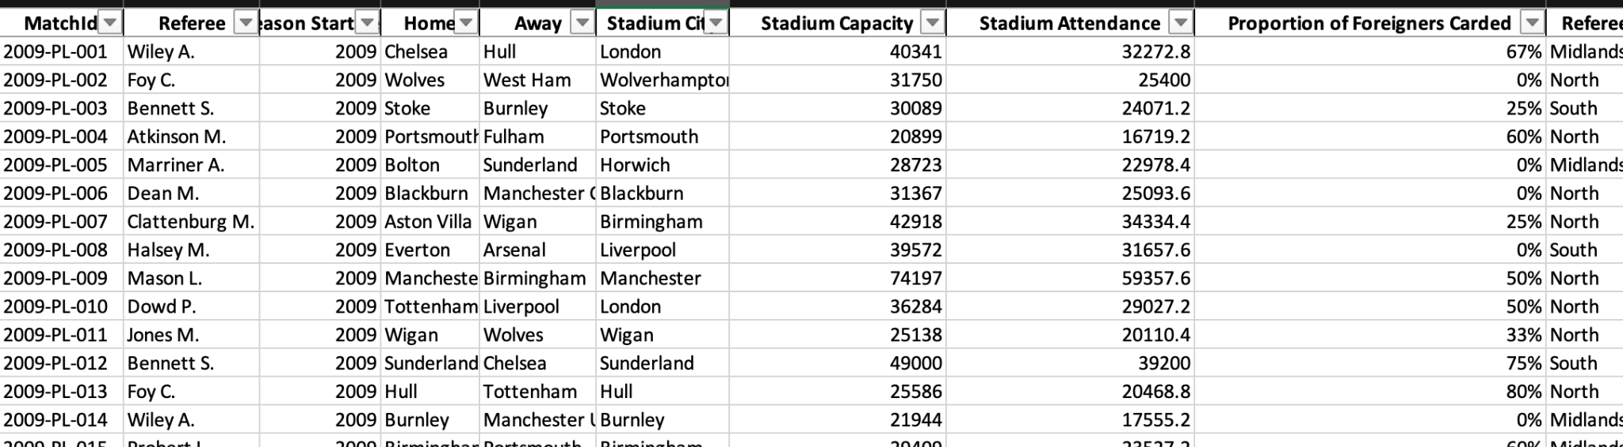
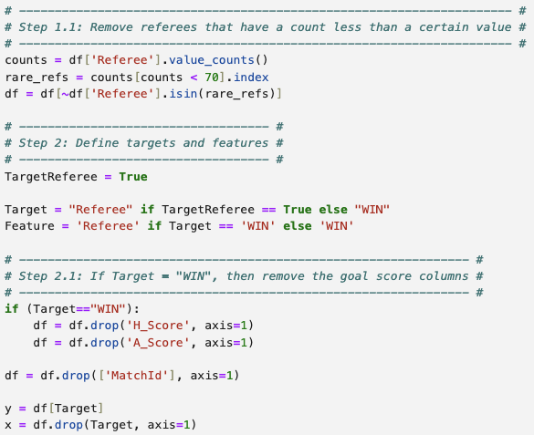
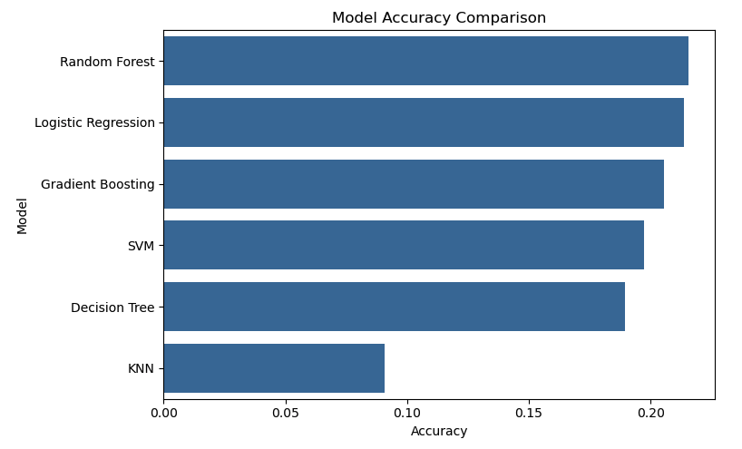
Model Pipeline
Using Scikit-Learn
[01] Load the Data
[02] Define Targets and Features
[03] Label Encode Target
[04] One-Hot Encode Key Categorical Columns
[05] Impute and Scale
[06] Split Train/Test [80/20]
[07] Train Random Forest
[08] Evaluate Performance [Feature Importance]
[09] Visualizations
[10] Multiple Models [Regression, Decision Tree, Gradient Boosting, SVM]

Slide 7
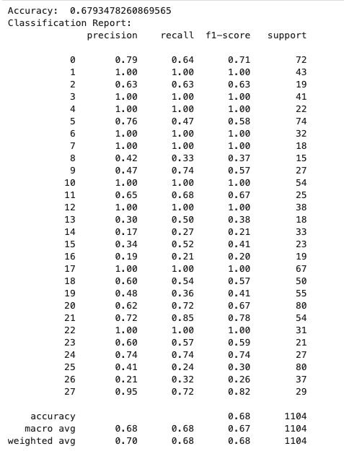
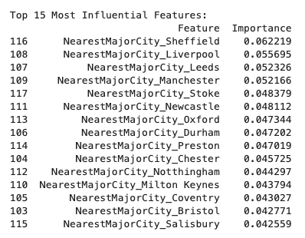
Initial Results
Started strong; model was predicting referees, some referees had 100% accuracy.
Data leakage with NearestMajorCity (Referee Birth City) feature.
Fix dramatically reduced accuracy.

Slide 8
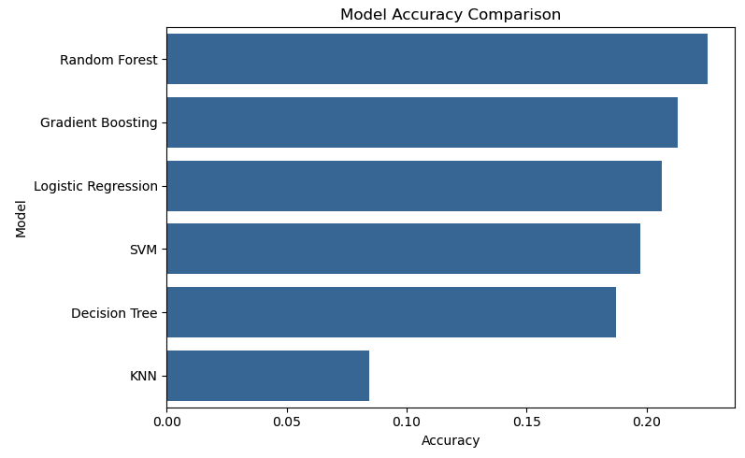
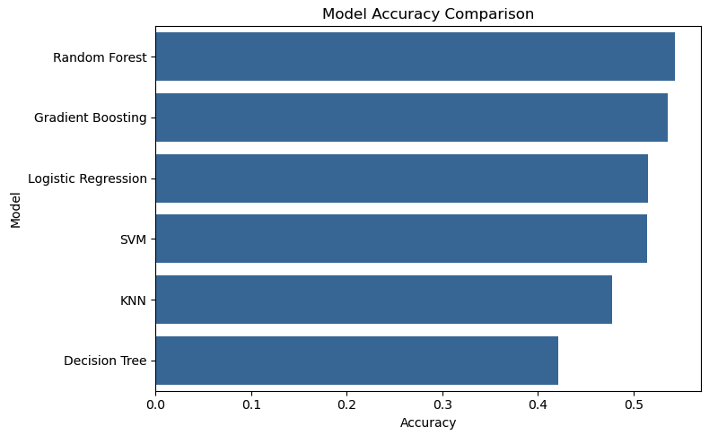
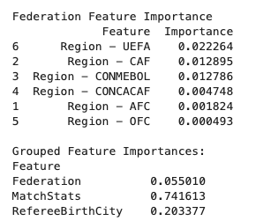
Final Results
Referee Predictor
Match Outcome Predictor
Racial Bias
Random Forest -
F1-Score Average Accuracy:
~ .22
Random Forest -
F1-Score Average Accuracy:
~ .51
Feature Importance:
Not Statistically Significant

Slide 9
Interpretation & Conclusion
Hypothesis | Conclusion
Referee Prediction | ❌
Match Outcome Prediction | ❌
Foreign Player Discrimination/Racial Bias | ❌
Results show that patterns did not emerge from the features and scale of data that I used.
However, this does not rule out the existence of meaningful patterns.
Perhaps deeper, richer, more granular inputs/data could provide better results.

